Slide 1
Sentiment Analysis on Wine Reviews
BIS 634 Final Project
Qingyang Yu

Slide 2
Overview
Bacground and Motivation
Description on Dataset
Data Acquisition
Data Cleaning
Data Analysis
Summary Statistics
Univariate Analysis
Bivariate Analysis
Multivariate Analysis
Word Frequency Analysis
Sentiment Analysis
Web Interface
API server
Web front-end
Discussion
Conclusion
Difficulties

Slide 3
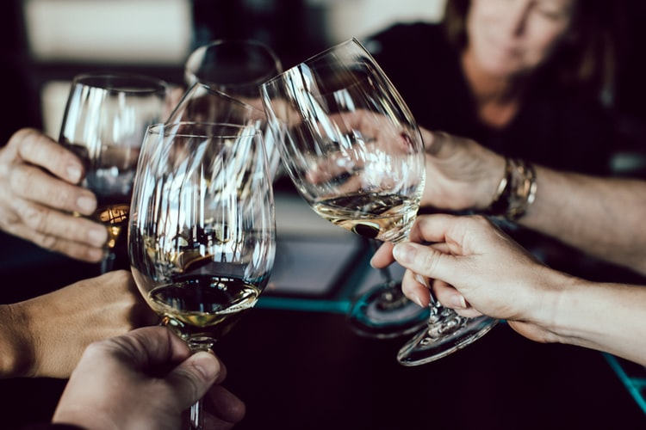
Background and Motivation
Only professionals could do wine tasting!
No!

Slide 4
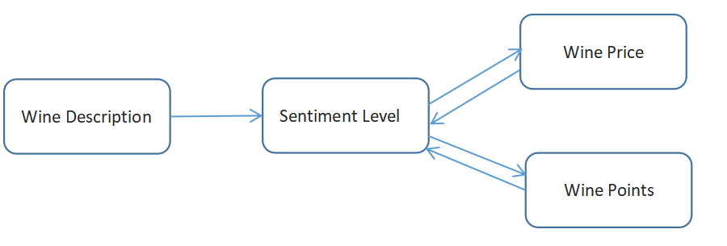
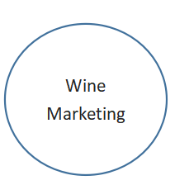
Background and Motivation
Data Cleaning
Sentiment Analysis
Whether wine description could reflect sentiment level of human’s subjective emotions？
Whether wine price, wine points are associated with sentiment level？

Slide 5
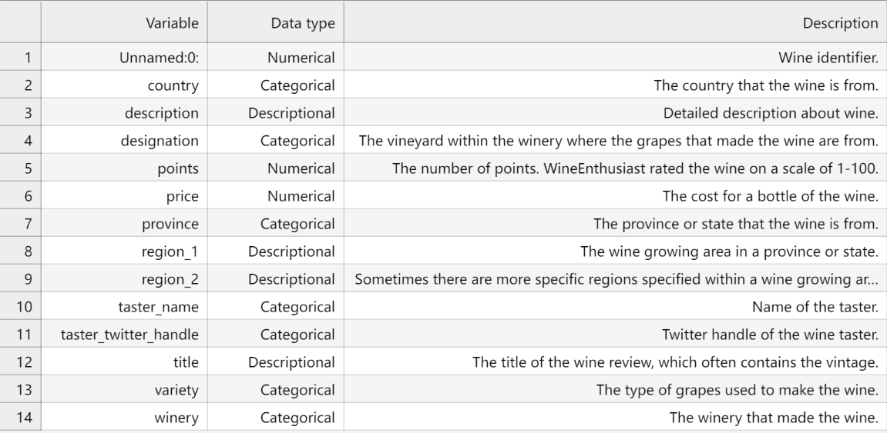
Description on Dataset
Originated from WineEnthusiast
Contain 130k wine reviews
14 variables(categorical, numerial, descriptive)
Wine description, points, price and variety

Slide 6
Data Acquisition
CSV file format
Download at kaggle public data repositories on Dec. 05th.
Well-annotated metadata accessible.
Data License: CC BY-NC-SA 4.0
I am free to:
share(copy and redistribute the material in any medium or format);
adapt(remix, transform, and build upon the material).

Slide 7
Data Cleaning
Missing values
For columns contain fewer missing values(i.e., country, province and variety)
->drop the rows include null values.
For columns contain many null values and not quite meaningful(i.e., Unnamed:0 and region_2)
->simply drop the columns
For columns contain many null values but the most common value not representative(i.e., designation, region_1)
->replace null values with ‘Unknown’.
For columns that have similar meanings(i.e., taster_name and taster_twitter_handle)
->drop one of the column taster_twitter_handle. And replace missing values with Unknown.
For numeric column(i.e., price)
->replace null values with medians

Slide 8
Data Cleaning
Duplicates
Duplicated in ‘description’ and ‘title’
Remove
Text Mining
Turn words into lowercase, remove punctuation.
Tokenize sentences.
Lemmatize each token(e.g. walk, walked, walking -> walk).
Analyze on N-gram, when n = 2.

Slide 9
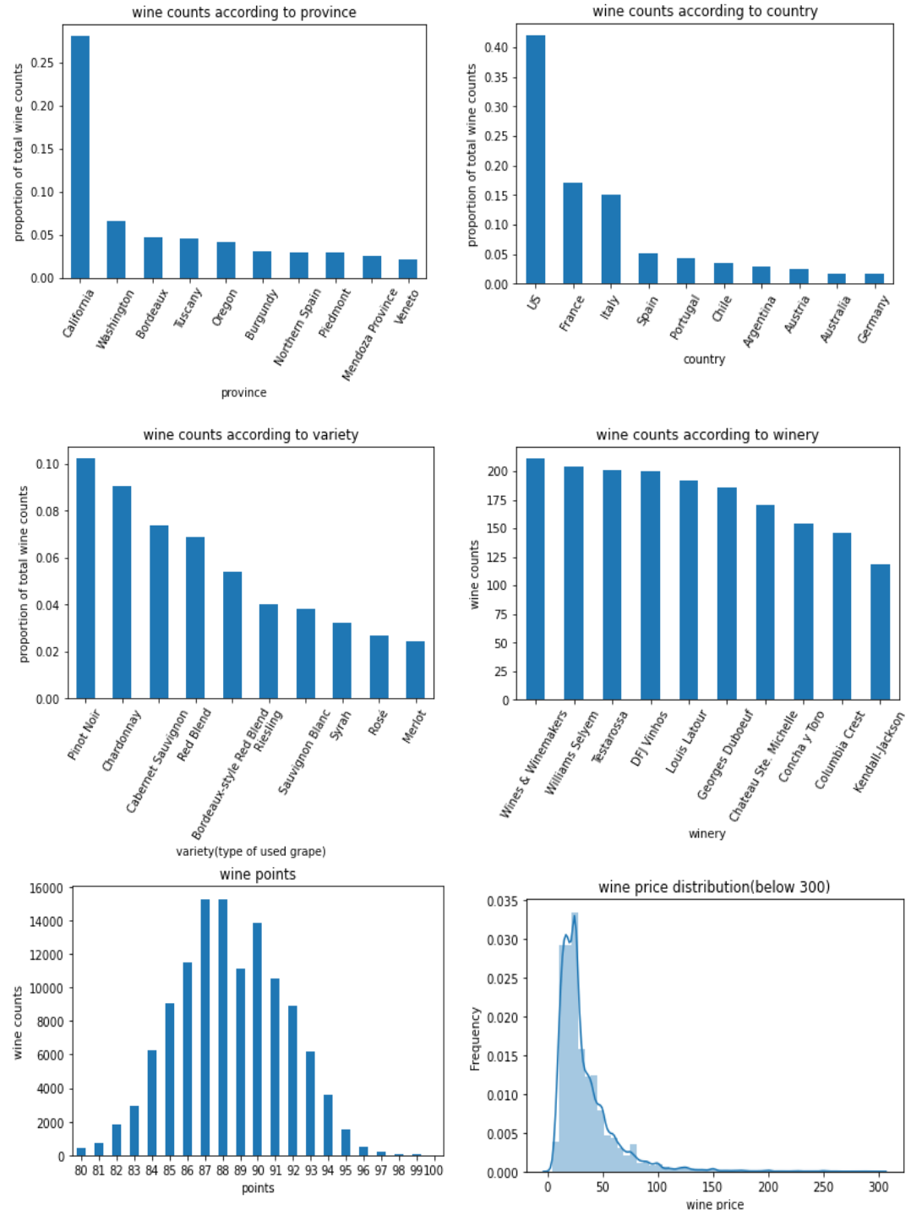
Data Analysis Summary statistics
Is there any ways summary statistics might be misleading?
Histogram of price, skewed by outliers
Any solutions?
Exclude wine price that over $300.

Slide 10
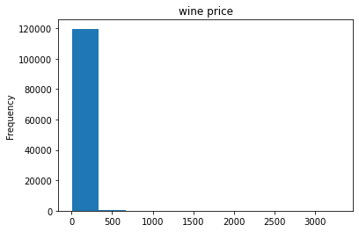
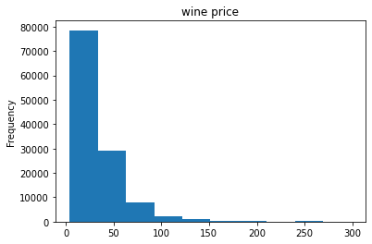
Data Analysis Summary statistics
Is there any ways summary statistics might be misleading?
Histogram of price, skewed by outliers
Any solutions?
Exclude wine price that over $300.

Slide 11
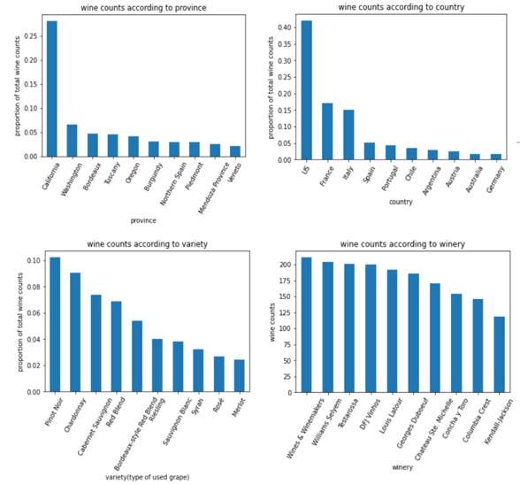
Data Analysis Univariate Analysis
What is the wine province distribution(relative proportions)?
California (~1/3)
What is the wine country distribution(relative proportions)?
US (>40%)
What is the most reviewed type of grape?
Pinot Noir (>10%)
Is there any winery the major supplier of wines?
No major wine supplier

Slide 12
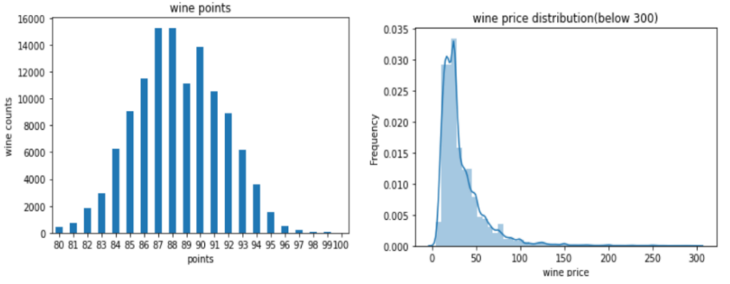
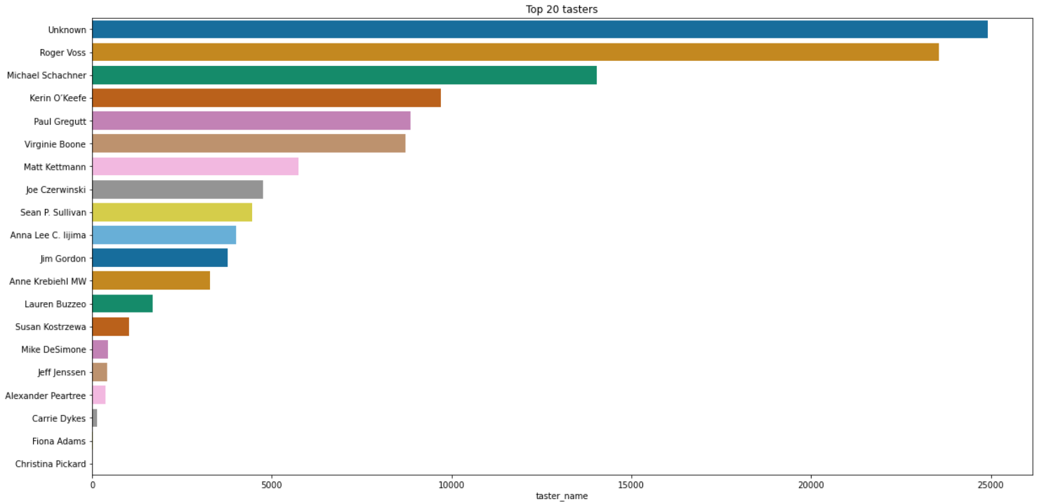
Data Analysis Univariate Analysis
What is the pattern in terms of wine points or price?
Wine point
Range from 80 to 100
Most score are 87, 88, 90
Normal distribution
Wine price
Range from 5 to 100
Not too expensive
Who reviewed most number of wines?
Roger Voss

Slide 13
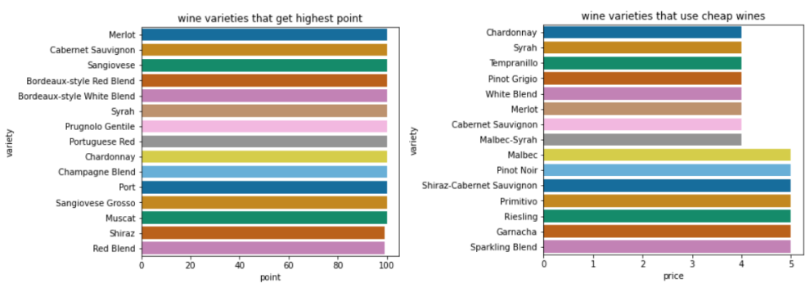
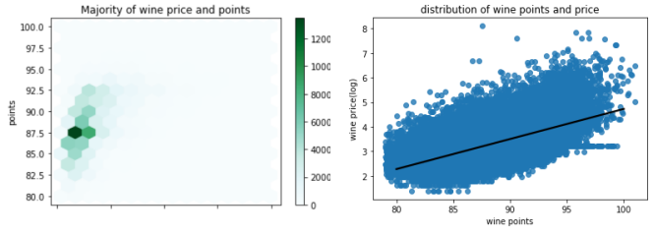
Data Analysis Bivariate Analysis
Which variety (type of grape) would be best to make wine?
Merlot, Cabernet Sauvignon, Syrah, Portuguese Red, Chardonnay(score 100, $4)
Is there any relationship between wine points and price?
For wine price < 200, most wines earn 87.5 points, price around 15
Wine with highest price only got a moderate points
The highest rated wine is not the most expensive ones

Slide 14
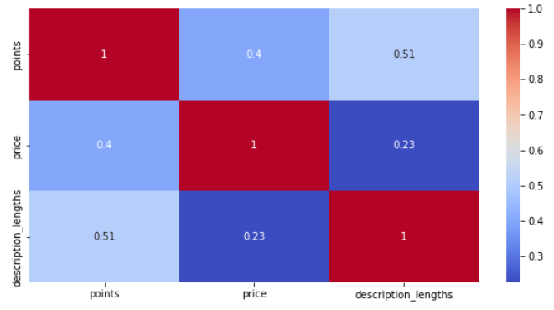
Data Analysis Multivariate Analysis
Is there any relationship among all wine features? Is the relationship weak/moderate/strong?
Positive correlation between wine price and points (very weak, ~0.4)
A stronger correlation between description length and points(~0.51)
Longer wine desciption->higher score

Slide 15
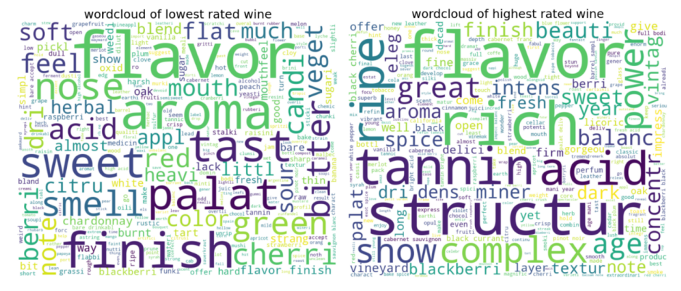
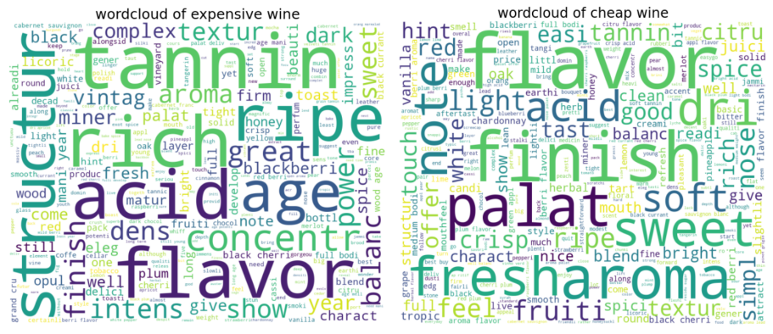
Data Analysis Word Frequency Analysis
What are some common terms appeared in the lowest rated and highest rated wine?
Flavor, adjectives(palate or taste)
What should a wine company keep in mind to get good reviews?
To get good scores -> aging, concentration and aroma
What should a wine company keep in mind to get good reviews?
Expensive wines are more associated with wine age

Slide 16
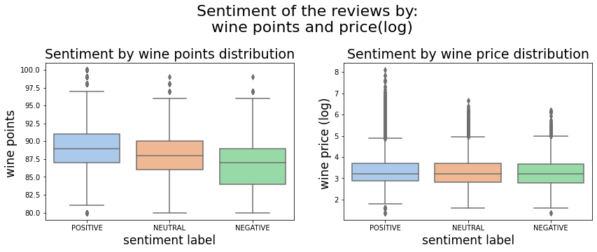
Data Analysis Sentiment Analysis
Is sentiment level related to wine points or price?
Sentiment level not influence wine price
Sentiment level affects wine points
If wine description are predicted as ‘positive’ level -> more likely to have a higher score

Slide 17
Web Interface API server
flask application
/
render homepage
/univariateAnalysis
render univariateAnalysis
/bivariateAnalysis
render bivariateAnalysis
/WordFrequencyAnalysis
render WordFrequencyAnalysis
/SentimentAnalysis
render SentimentAnalysis
/MultivariateAnalysis
render
MultivariateAnalysis
/background
render background
/dataset
render dataset
/number
render number
show data in a table
/Analysis
render Analysis
do sentiment analysis
app.py
main function
run

Slide 18
Conclusion
- To get a good wine points, aging, concentration and aroma are important factors.
- Wine age is an important factor for customers that prefer expensive wines.
- Description length and wine points has a stronger correlation.
- Each country has its own characteristic and description of wine, indicates different wine drinking style, different wine tastes and wine ingredients.
- Sentiment level affects the wine points.

Slide 19
Difficulties
- Text mining
- API implementation

Slide 20
Thank you for listening!

